Slide 1

WEB Development
Grade 7&8

Slide 2
Recap of the last Class
Notes:
Objective:
Review the previous lesson on Navigation and Hero Section.
Introduce the new topic: Scroll Animation.
Teacher Instructions:
Navbar:
Recap the purpose of a navbar and its importance in providing easy access to different sections of a website.
Emphasis on User Experience:
Discuss how a well-designed navbar improves user experience by making navigation intuitive and straightforward.
Explain how an intuitive navbar can help a website to grow by retaining users and encouraging them to explore more content.
Hero Section:
Recap the purpose of the hero section as the prominent, eye-catching part of a webpage, usually located at the top.
Explain its role in grabbing the user's attention and communicating the primary message or call to action.
Introduce today's topic:
Scroll Animation:
Learning About Scroll Animation:
Introduce the concept of scroll animations and their purpose in enhancing the user experience by adding visual interest.
Explain how scroll animations can make a website more engaging and interactive.
Crafting the "Go Green" Page:
Outline the steps to create a "Go Green" webpage with an interactive hero section and scroll animations.

Slide 3
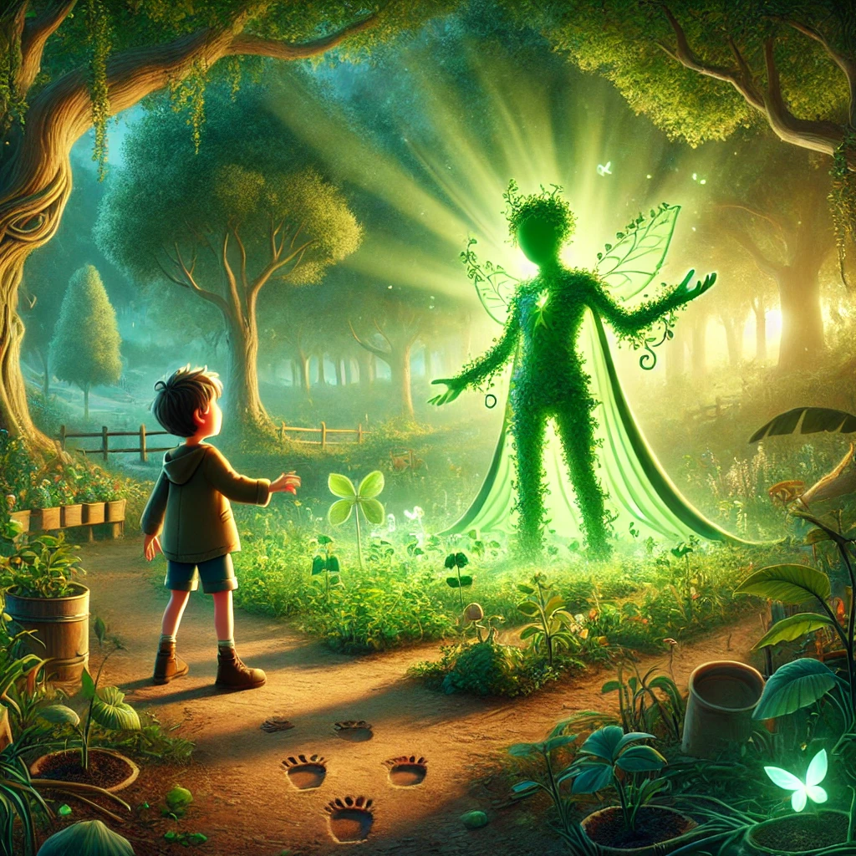
The Mystery of the Green Guardian.
In the town of Eco Ville, everyone was puzzled by a mysterious change in their beloved park. Every morning, they found new plants growing overnight, but no one knew how they got there.
One day, a clever child named Sam decided to solve the mystery. They followed the clues: footprints in the soil, a trail of seeds, and a gentle hum in the air. As they reached the heart of the park, they discovered the answer.
A magical creature called the Green Guardian was planting seeds to make Eco Ville greener. The Green Guardian asked Sam, "I have no eyes, yet I see everything. I have no hands, yet I plant trees. What am I?"
Can you solve the riddle and help Sam?
Notes:
Objective:
Introduce the Riddle Story:
The answer to the riddle is "The Wind."
The wind has no eyes but can see everything by moving around. It has no hands but can carry and plant seeds, helping new plants to grow.

Slide 4
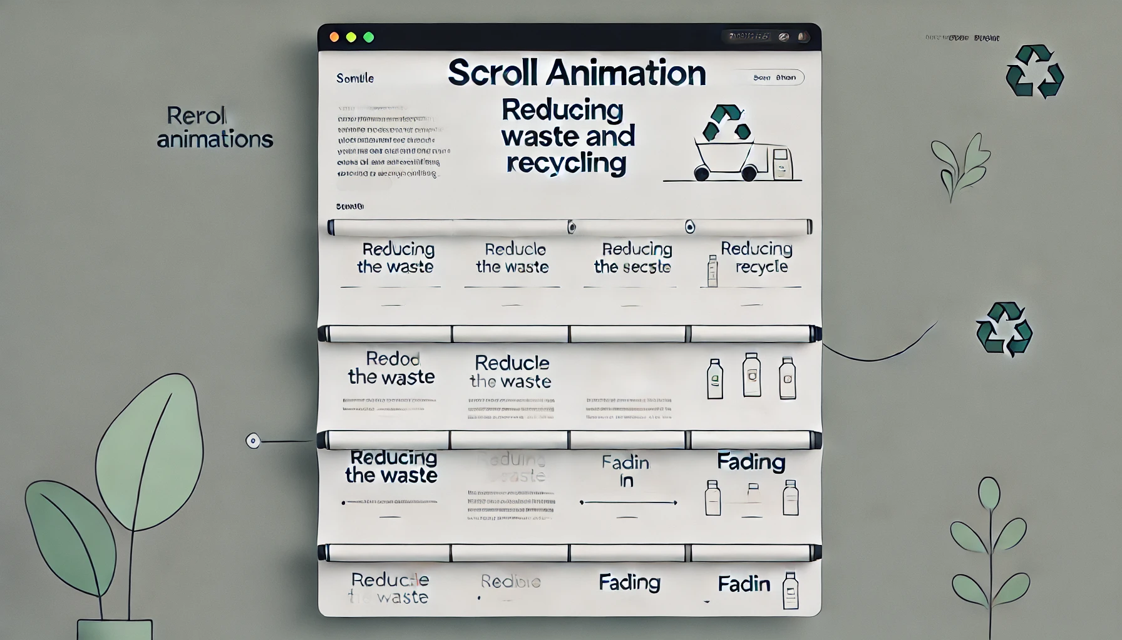
Continuation of Go Green Webpage and Scroll animation
Notes:
Objective:
Continuation of the project
Teacher Instructions:
Introduction to Scroll Animations:
Purpose: Explain how scroll animations capture attention and enhance user experience.
Basic Techniques: Introduce simple CSS animations (e.g., sliding in from the sides, fading in).

Slide 5

Project – Go Green Pathways: Paving a Sustainable Future
Notes:
Project Link: Go Green Pathways
Objective:
Present the final project example.
Teacher Instructions:
Show the Screenshot:
Display the screenshot of the final project example.
Show the Project in Live Action:
Demonstrate the project on a live website to show how it functions.
Navigate through the website to showcase the scroll effect in action.
Emphasize the importance of both elements in creating an engaging and easy-to-use website.
Explain the Project:
Inform students that they will create a similar project.
Highlight the key features:
A clear and user-friendly hero section.
An engaging webpage using scroll animation.

Slide 6
Recap of code
Notes:
Objective:
Review the code till now
Project Link: Go Green Pathways
Teacher Instructions:
Recap the code what has been done till now .

Slide 7
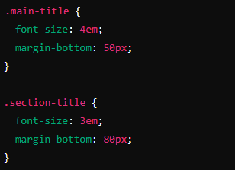
Working with the Project
Styles the Title Styles
Notes:
Objective:
Project Link: Go Green Pathways
Explain the CSS code for styling the Title Styles.
Teacher Instructions:
Display the screenshot of the CSS code.
Explain the styling for the Title Styles:
.main-title: Styles for the main title.
font-size: 4em;: Sets the font size.
margin-bottom: 50px;: Adds space below the title.
.section-title: Styles for section titles.
font-size: 3em;: Sets the font size.
margin-bottom: 80px;: Adds space below the title.

Slide 8
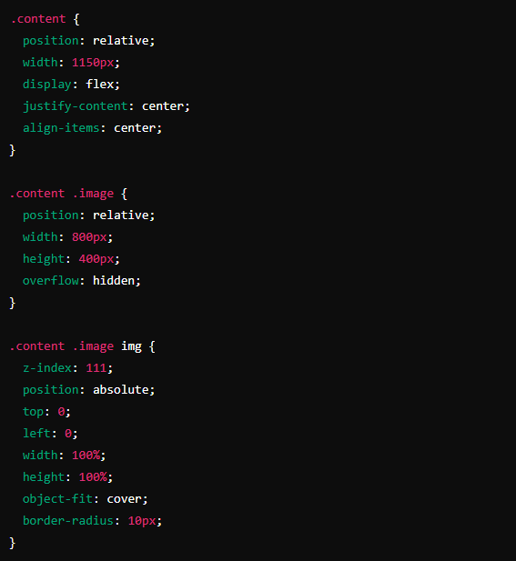
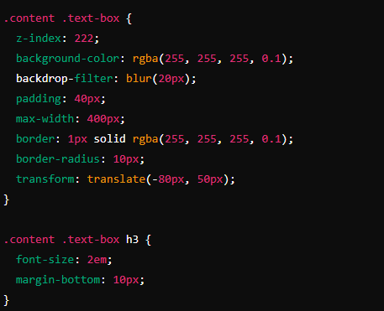
Working with the Project
Content Styles
Notes:
Objective:
Explain the CSS code to style image text-box.
Teacher Instructions:
Display the screenshot of the CSS code.
Explain the styling for content:
.content: Styles for content class.
position: relative;: Sets the position relative to its normal position.
width: 1150px;: Sets the width.
display: flex;: Applies flexbox layout.
justify-content: center;: Centers content horizontally.
align-items: center;: Centers content vertically.
.content .image: Styles for image class within content.
position: relative;: Sets the position relative to its normal position.
width: 800px;: Sets the width.
height: 400px;: Sets the height.
overflow: hidden;: Hides overflow content.
.content .image img: Styles for img element within image class.
z-index: 111;: Sets the stack order.
position: absolute;: Sets the position absolute.
top: 0;: Positions the element at the top.
left: 0;: Positions the element at the left.
width: 100%;: Sets the width to 100%.
height: 100%;: Sets the height to 100%.
object-fit: cover;: Resizes the image to cover the container.
border-radius: 10px;: Rounds the corners.
.content .text-box: Styles for text-box class within content.
z-index: 222;: Sets the stack order.
background-color: rgba(255, 255, 255, 0.1);: Sets the background color with transparency.
backdrop-filter: blur(20px);: Applies a blur effect.
padding: 40px;: Adds padding inside the box.
max-width: 400px;: Sets the maximum width.
border: 1px solid rgba(255, 255, 255, 0.1);: Adds a border with transparency.
border-radius: 10px;: Rounds the corners.
transform: translate(-80px, 50px);: Moves the element.
.content .text-box h3: Styles for h3 element within text-box.
font-size: 2em;: Sets the font size.
margin-bottom: 10px;: Adds space below the title.

Slide 9
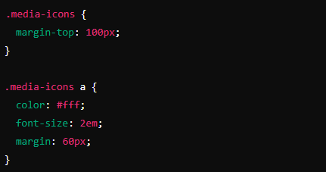
Working with the Project
Styles Media Icons
Notes:
Objective:
Explain the CSS code to Styles the Media Icons.
Teacher Instructions:
Display the screenshot of the CSS code.
Explain the styling for the Media Icons:
.media-icons: Styles for media-icons class.
margin-top: 100px;: Adds space above the icons.
.media-icons a: Styles for anchor elements within media-icons.
color: #fff;: Sets the text color to white.
font-size: 2em;: Sets the font size.
margin: 60px;: Adds space around the icons.

Slide 10
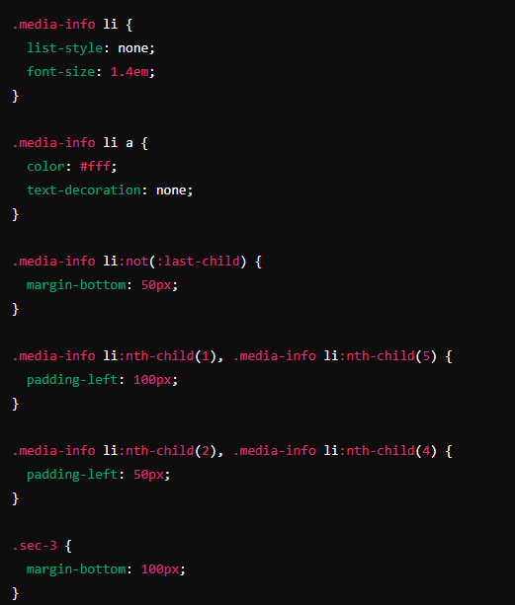
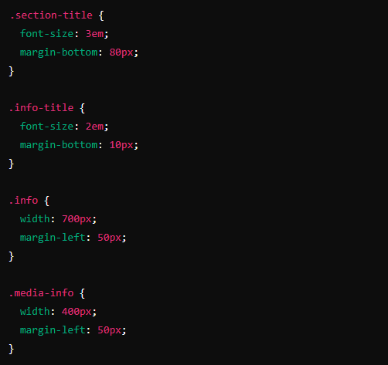
Working with the Project
Section 2 and 3 Styles
Notes:
Objective:
Explain the CSS code to Styles section 2 & 3.
Teacher Instructions:
Display the screenshot of the CSS code.
Explain the styling for the title font li elements in section 2 & 3:
.section-title: Styles for section titles.
font-size: 3em;: Sets the font size.
margin-bottom: 80px;: Adds space below the title.
.info-title: Styles for info titles.
font-size: 2em;: Sets the font size.
margin-bottom: 10px;: Adds space below the title.
.info: Styles for info class.
width: 700px;: Sets the width.
margin-left: 50px;: Adds left margin.
.media-info: Styles for media-info class.
width: 400px;: Sets the width.
margin-left: 50px;: Adds left margin.
.media-info li: Styles for list items within media-info.
list-style: none;: Removes default list style.
font-size: 1.4em;: Sets the font size.
.media-info li a: Styles for anchor elements within media-info list items.
color: #fff;: Sets the text color to white.
text-decoration: none;: Removes the underline from links.
.media-info li:not(:last-child): Styles for all list items except the last one.
margin-bottom: 50px;: Adds space below the list items.
.media-info li:nth-child(1), .media-info li:nth-child(5): Styles for the first and fifth list items.
padding-left: 100px;: Adds left padding.
.media-info li:nth-child(2), .media-info li:nth-child(4): Styles for the second and fourth list items.
padding-left: 50px;: Adds left padding.
.sec-3: Styles for the sec-3 class.
margin-bottom: 100px;: Adds space below the section.

Slide 11
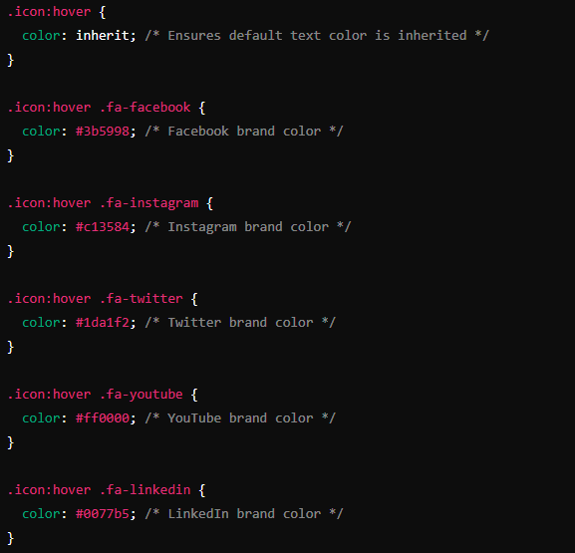
Working with the Project
Hover Effects on Icons
Notes:
Objective:
Explain how to change icon colors on hover with .icon:hover and specific icon classes.
Teacher Instructions:
Display the screenshot of the CSS code.
Explain the Hover sudo class in css:
.icon:hover: Styles for icons on hover.
color: inherit;: Inherits the default text color.
.icon:hover .fa-facebook: Styles for Facebook icon on hover.
color: #3b5998;: Changes color to Facebook's brand color.
.icon:hover .fa-instagram: Styles for Instagram icon on hover.
color: #c13584;: Changes color to Instagram's brand color.
.icon:hover .fa-twitter: Styles for Twitter icon on hover.
color: #1da1f2;: Changes color to Twitter's brand color.
.icon:hover .fa-youtube: Styles for YouTube icon on hover.
color: #ff0000;: Changes color to YouTube's brand color.
.icon:hover .fa-linkedin: Styles for LinkedIn icon on hover.
color: #0077b5;: Changes color to LinkedIn's brand color.
Go Back and Complete the Scroll Animation in Html and show the Beautiful effect to the students

Slide 12
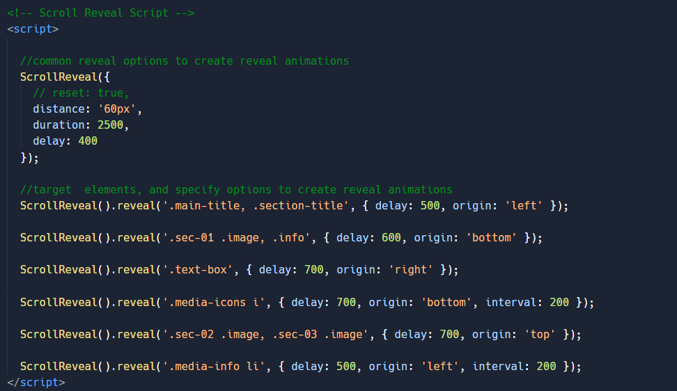
Scroll Reveal JS
Notes:
Objective:
Teacher Instructions:
Describe how to add scroll animations using the Scroll Reveal library.
Explain the common options for animations and how to target specific elements for reveals.
Show how to add scroll animation and show its functioning functions on a live website.
Demonstrate how to add animation form Scroll Reveal Js: https://scrollrevealjs.org/guide/hello-world.html
Tag Explanation:
Scroll Reveal: A JavaScript library for creating scroll animations.
ScrollReveal(): Initializes the Scroll Reveal library.
Common Reveal Options: Sets common options for all reveal animations, such as distance, duration, and delay.
distance: '60px': Elements move 60 pixels.
duration: 2500: Animation duration is 2500 milliseconds.
delay: 400: Animation starts after a 400-millisecond delay.
Reveal Configurations: Specifies options for revealing specific elements.
.main-title, .section-title: Elements revealed from the left after a 500-millisecond delay.
.sec-01 .image, .info: Elements revealed from the bottom after a 600-millisecond delay.
.text-box: Elements revealed from the right after a 700-millisecond delay.
.media-icons i: Icons revealed from the bottom with a 200-millisecond interval.
.sec-02 .image, .sec-03 .image: Images revealed from the top after a 700-millisecond delay.
.media-info li: List items revealed from the left with a 200-millisecond interval.

Slide 13
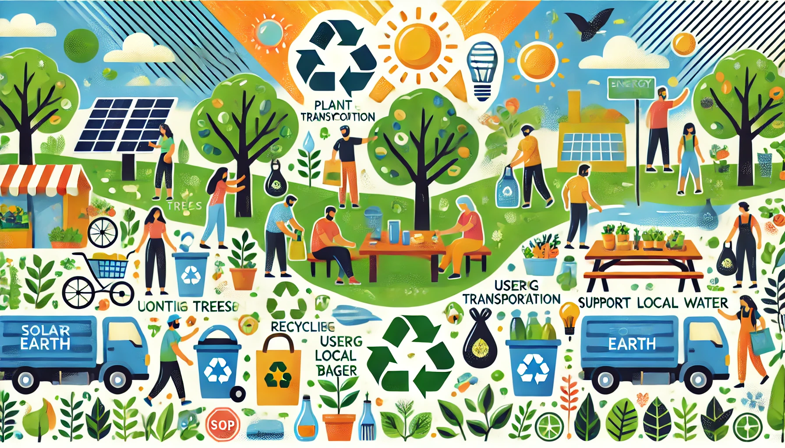
Now it's your turn!
Task:
Try to style the section added by all of you in the previous Lesson
Instructions: Share the code with others and work as a group to give your own personalization to the final web page.
Notes:
"Students' Activity"
Objective:
Allow students to use their creativity in designing the Help Mother Earth section
Teacher Instructions:
Present the student activity task
Instruct student's to complete it
Discuss the importance of small action and how it can change things in a bigger picture
Try to Discuss following points which will help them to create their project
Reduce, Reuse, Recycle: Minimize waste by reducing consumption, reusing items, and recycling materials like paper, plastic, and glass.
Conserve Water: Turn off taps while brushing, take shorter showers, and fix leaks promptly.
Save Energy: Turn off lights and electronics when not in use, use energy-efficient bulbs, and consider renewable energy sources.
Choose Sustainable Products: Opt for eco-friendly products and support companies that prioritize sustainability.
Plant Trees and Gardens: Trees absorb carbon dioxide and provide oxygen, while gardens support local wildlife and help combat climate change.
Use Public Transport: Reduce your carbon footprint by using public transportation, biking, or walking instead of driving.
Reduce Plastic Use: Use reusable alternatives to single-use plastics, like bottles, bags, and utensils.
Support Local and Organic: Buy local produce and organic foods to reduce your carbon footprint and avoid harmful pesticides.
Educate and Advocate: Spread awareness about environmental issues and support policies that protect the planet.
Compost: Composting reduces landfill waste and provides nutrient-rich soil for gardening.

Slide 14

How to Save & Share the project.
Replit offers autosave option – so not worry about the same.
To share project with someone in view mode: just copy the link from the URL bar, and share the link
To share the project for collaboration
Click on "Invite" from the top right corner
If you know the username, type it in the box and click on invite
You can also turn on the toggle button "private join link" to create a public collaboration link and invite members to edit your code.
Notes:
Instructions for the Teacher:
Explain how to save and share projects on Replit, including the options for collaboration.
Emphasize the importance of sharing projects for feedback and collaboration.

Slide 15


What property is used to ensure that the image inside the .content .image class fills its container while maintaining its aspect ratio?
a) object-position
b) object-fit
c) z-index
d) overflow
Notes:
Answer: b) object-fit

Slide 16
In the .text-box class, what is the purpose of the backdrop-filter: blur(20px); property?
a) It changes the color of the text.
b) It blurs the background behind the text box.
c) It adds a border around the text box.
d) It changes the size of the text.
Notes:
Answer:b) It blurs the background behind the text box.

Slide 17
Which of the following selectors correctly targets all media icons and changes their color on hover?
a) .media-icons:hover
b) .icon:hover .fa-facebook
c) .media-info li a:hover
d) .icon:hover .fa-instagram
Notes:
Answer: b) .icon:hover .fa-facebook

Slide 18
What CSS property is used to create space between the bottom of the .section-title class and the next element?
a) padding
b) margin-bottom
c) margin-top
d) padding-bottom
Notes:
b) margin-bottom

Slide 19

What have we learnt?
What We Learned Today
HTML Basics
DOCTYPE Declaration:
<!DOCTYPE html>
HTML Structure:
<html>, <head>, <body>, <section>, <div>, <h2>, <h3>, <p>, <ul>, <li>, <img>, <a>
Linking External Resources:
<link>, @import, <script>
Notes:
Objective:
Summarize the key learnings from the lesson.
Teacher Instructions:
Review the tags
Ask the student to explain the tags one by one

Slide 20
What have we learnt?
What We Learned Today
CSS Styling
Global Styles:
*, html, body, margin, padding, box-sizing, font-family, background
Flexbox Layout:
display: flex;, flex-direction, justify-content, align-items
Text and Media Styling:
font-size, color, width, height, border-radius, object-fit
Hover Effects:
:hover, color
Notes:
Objective:
Summarize the key learnings from the lesson.
Teacher Instructions:
Review the css selectors and attributes
Ask the student to explain the attributes one by one or explain by yourself

Slide 21

Homework Discussion
Notes:
Instructions for the Teacher: Facilitate a discussion about the homework assignment.

Slide 22
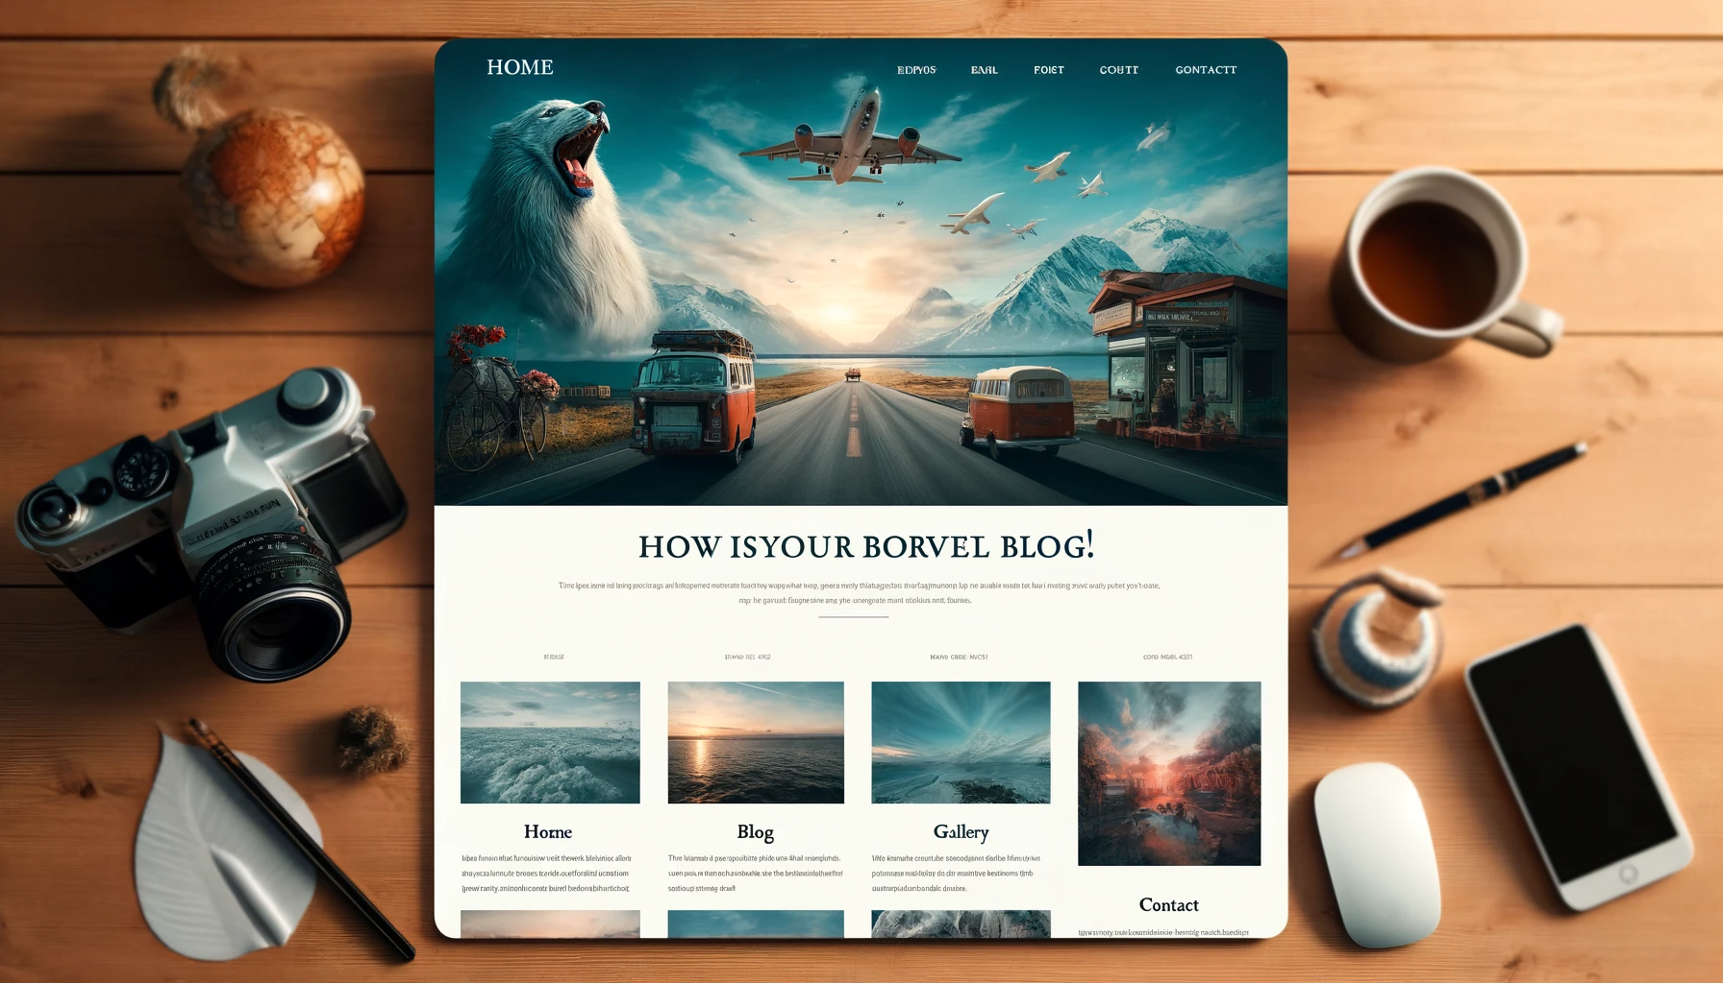
Brain Booster Bonus
Brain Booster Activity: Create a Travel Blog Website
Design a travel blog website to share travel experiences, photos, and tips. This project will reinforce your HTML, CSS, skills.
Notes:
Objective: Instruct the student to create a Travel Blog Website While following the below guidelines.
Features to Include:
Homepage:
Hero section with a background image
Navigation bar
Brief introduction about the blog
Blog Section:
List of blog posts with images, titles, and descriptions
Links to detailed blog pages
Contact Form:
Fields for name, email, subject, and message

Slide 23

Be Skeptical of Promises
If something online sounds too good to be true, like 'free games for life,' it could be a trick.
Oliver saw an ad online promising "free games for life" and eagerly clicked on it, hoping for a great deal.
Instead, his computer got infected with malware, causing a lot of problems.
The moral of the story: don't believe ads or emails promising free stuff without checking with an adult first, as it could be a trick.

